Slide 1
GGP-Austria
…from the start to an open end
Norbert Neuwirth and Isabella Buber-Ennser

Slide 2
Project phases of GGP.at 2022/23
Selected results
Experiences from dissemination
Future trajectory

Slide 3
Project phases

Slide 4
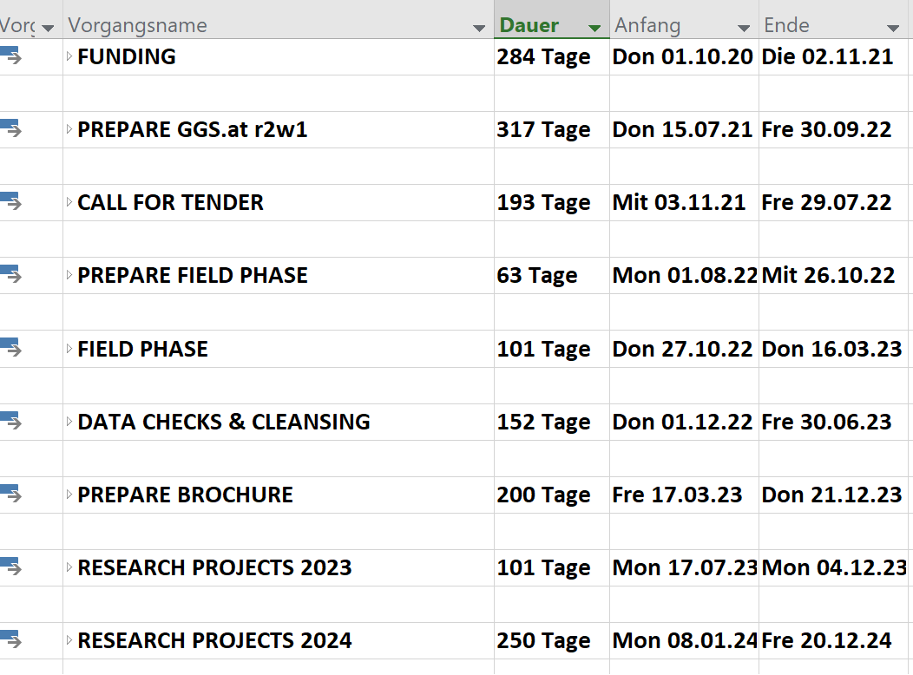

Slide 7
Selected results

Slide 8
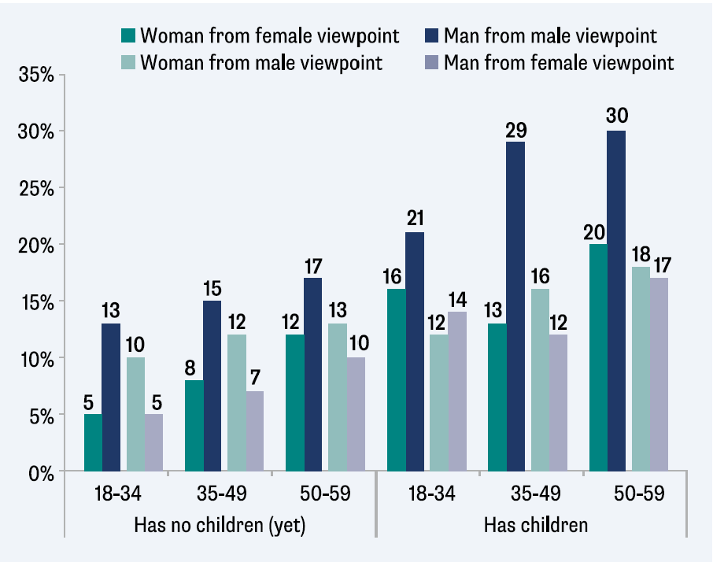
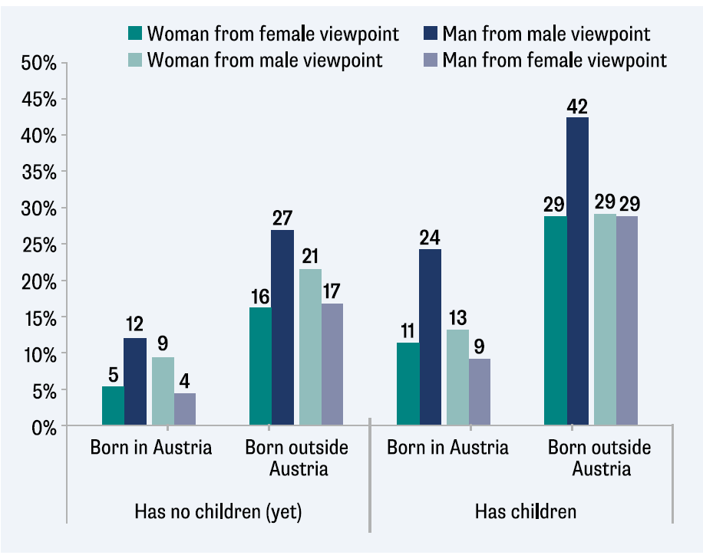
Are children important for a fulfilled life?
For men, children seem to be far more important!
People from abroad give higher values on children, but the gender differences are still comparable
Source: Schmidt & Neuwirth (2003; [21])

Slide 9
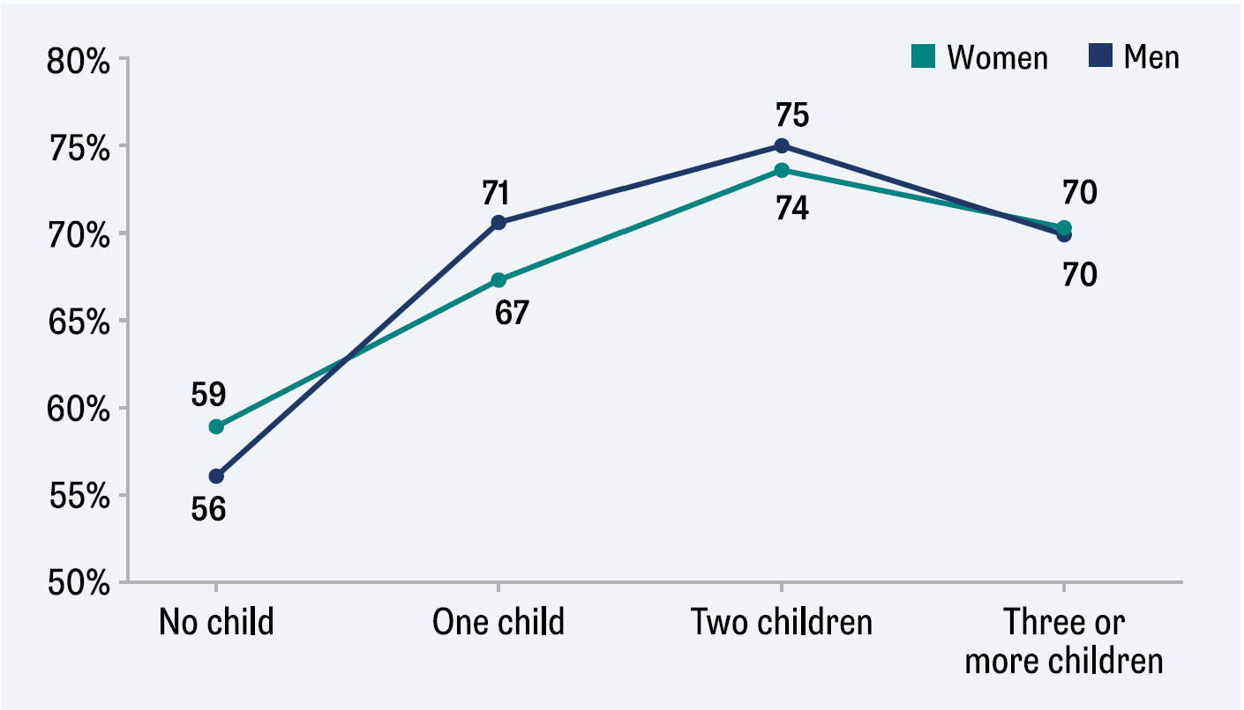
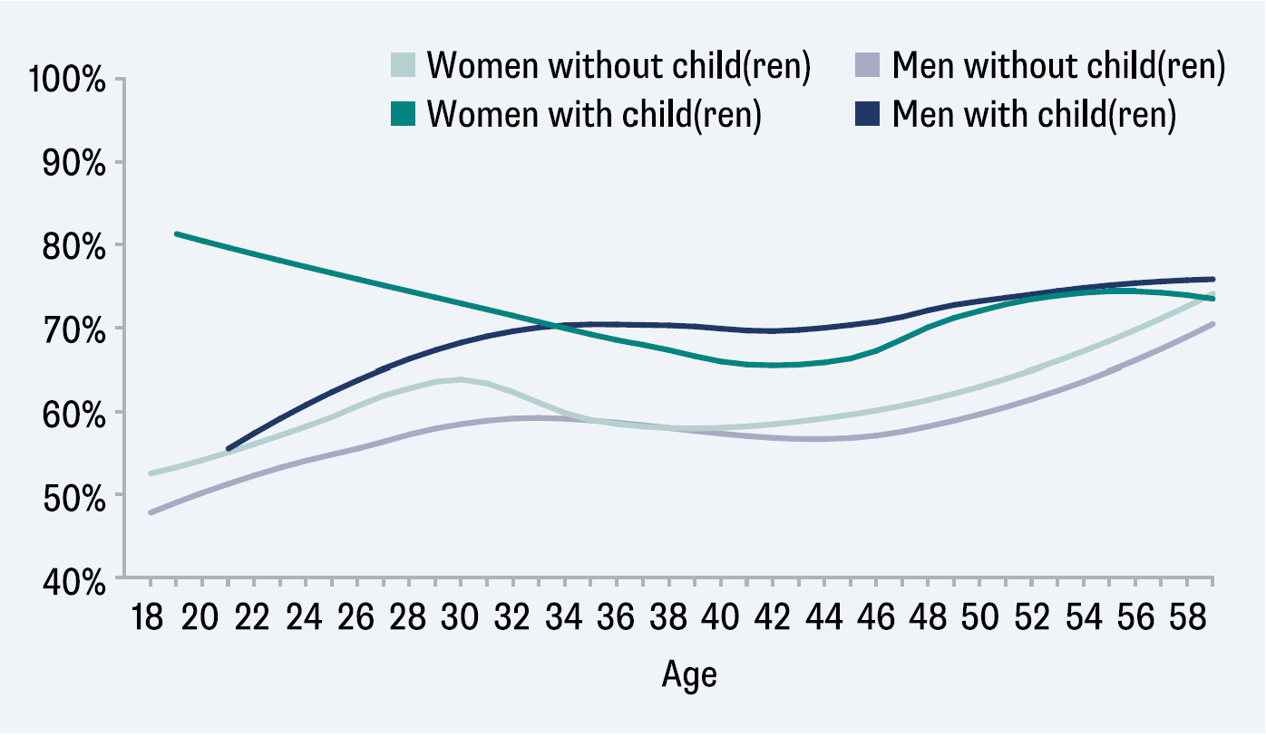
Children and life satisfaction
Life satisfaction seems to take a decelerating increase with number of children
Higher share of people with high life satisfaction (>7) when having children in all age cohorts
Source: Buchebner-Ferstl / Baierl (2023; [55])

Slide 10
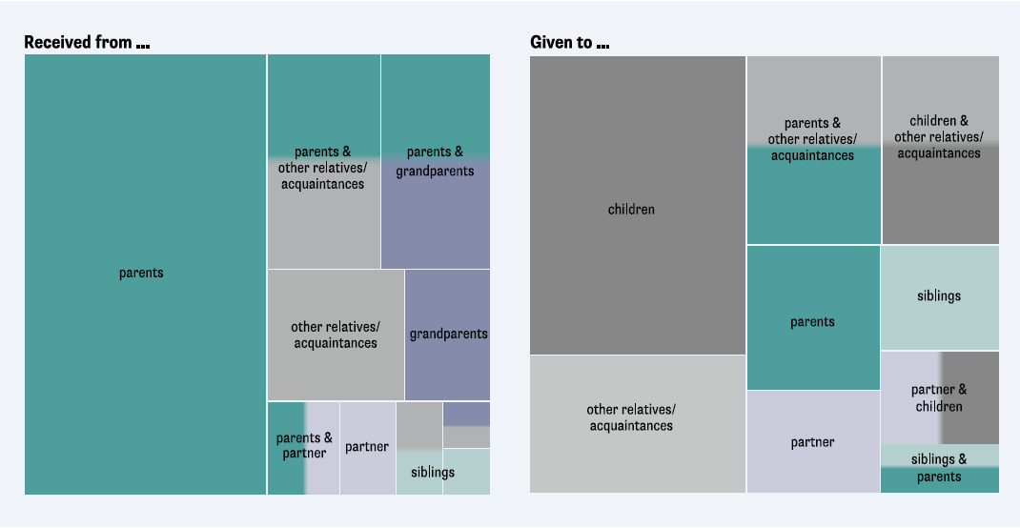
Intra-family transfers – about receiving and giving
Groups of people involved in transfers
Source: Wernhart (2023; [50])

Slide 11
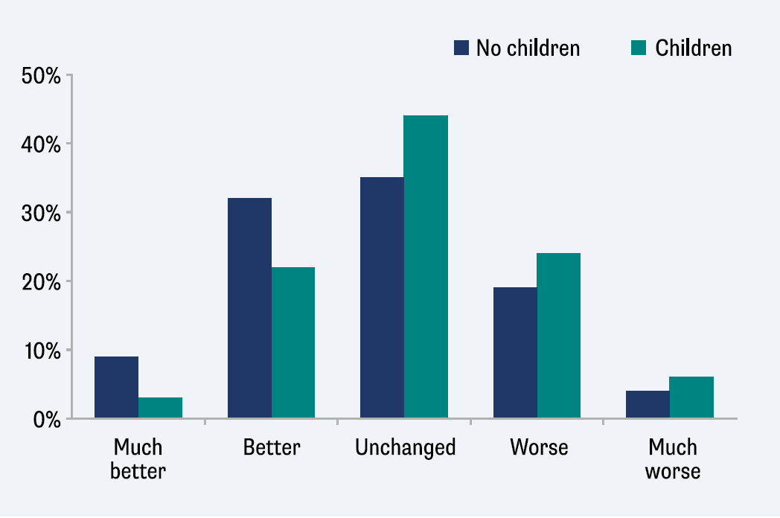
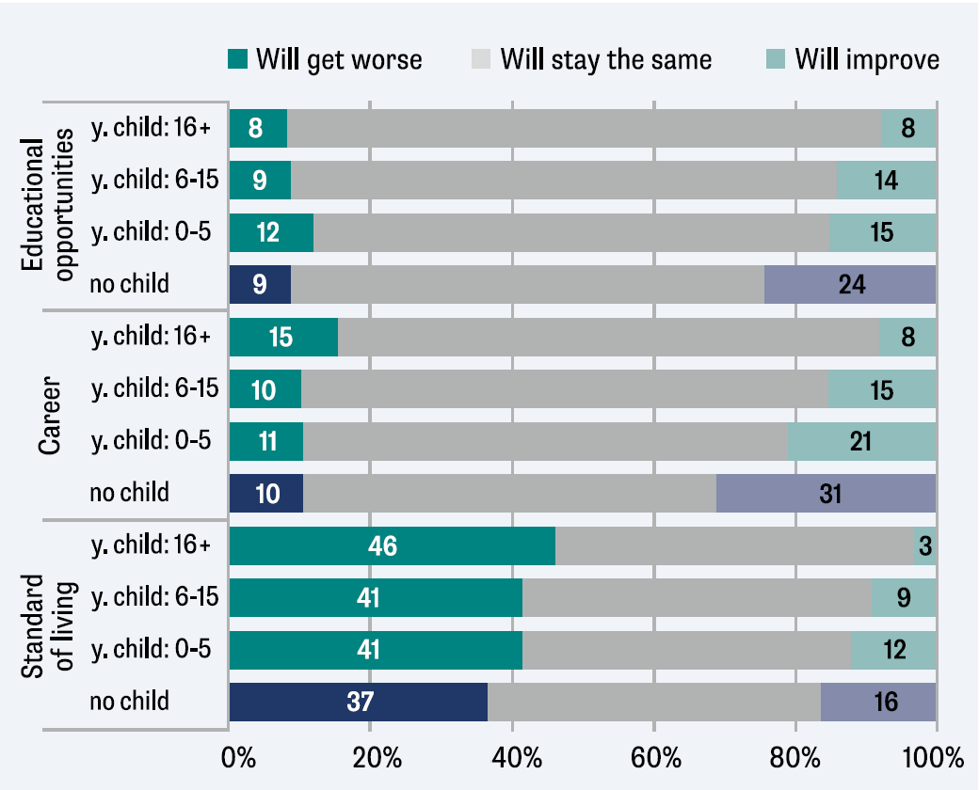
The impact of crises: what do families expect?
Childless seem to be more optimistic regarding their household income development
Childless in general more optimistic. Less differences on the side of the pessimists
Source: Neuwirth (2023; [64])

Slide 12
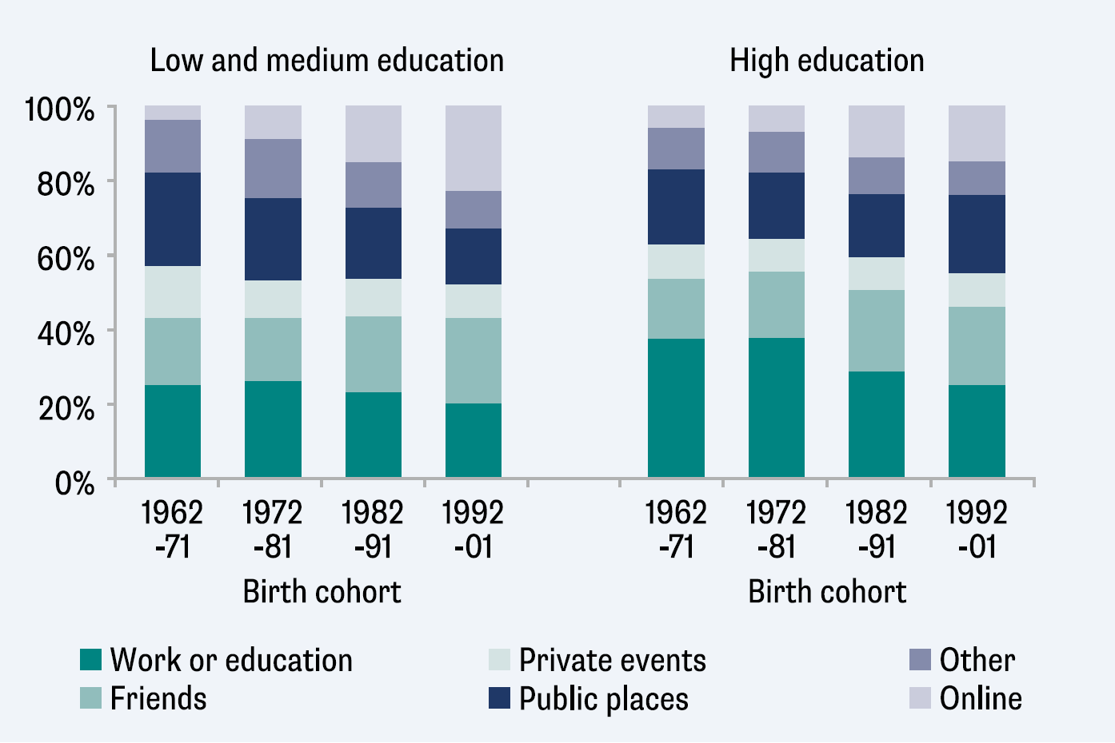
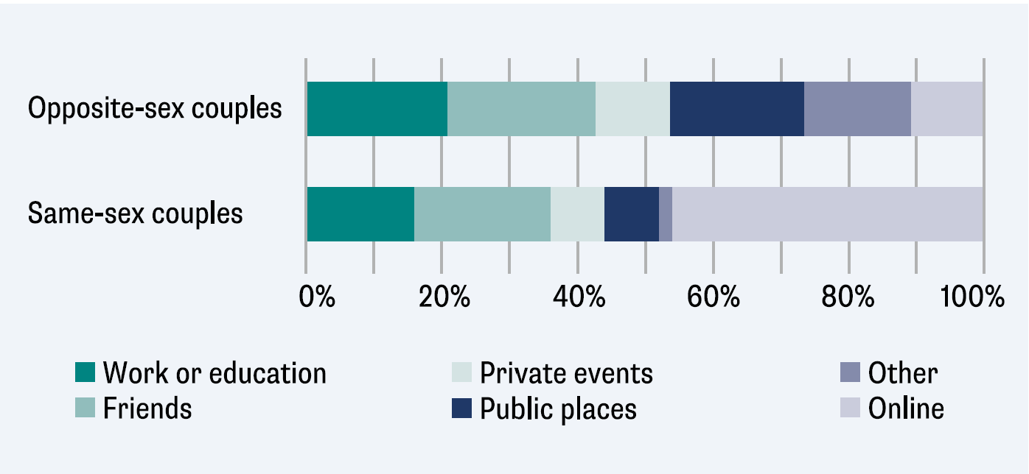
Where do couples meet?
Where partners first meet varies by educational level and birth cohort
Same-sex partners meet more often online and less often in public places
Source: Compans & Beaujouan (2023; [4])

Slide 13
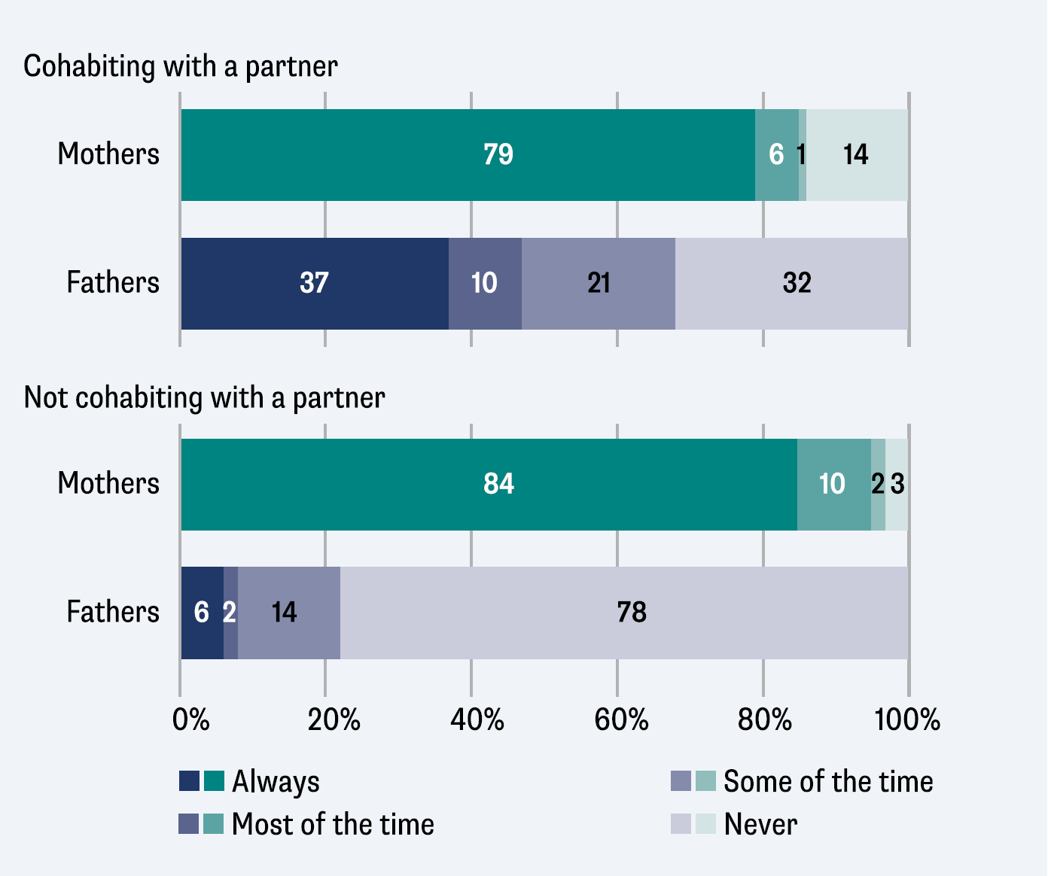
Who do minors live with?
Cohabitation with minor children depends on fathers‘ partnership context
Source: Buber-Ennser & Herbst (2023; [15])

Slide 14
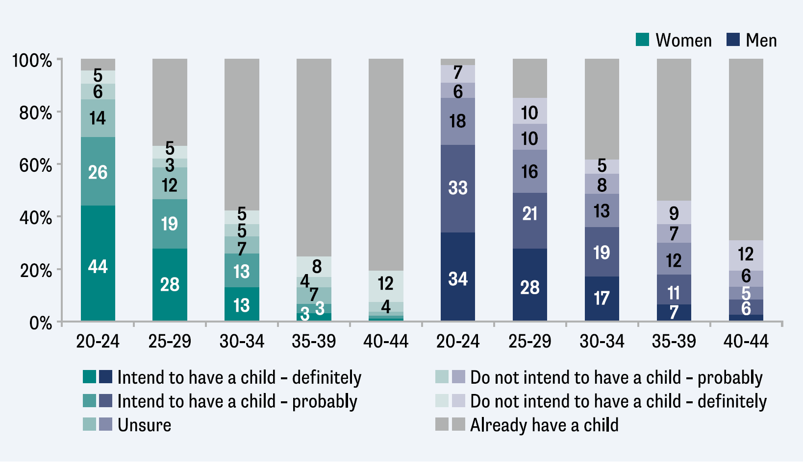
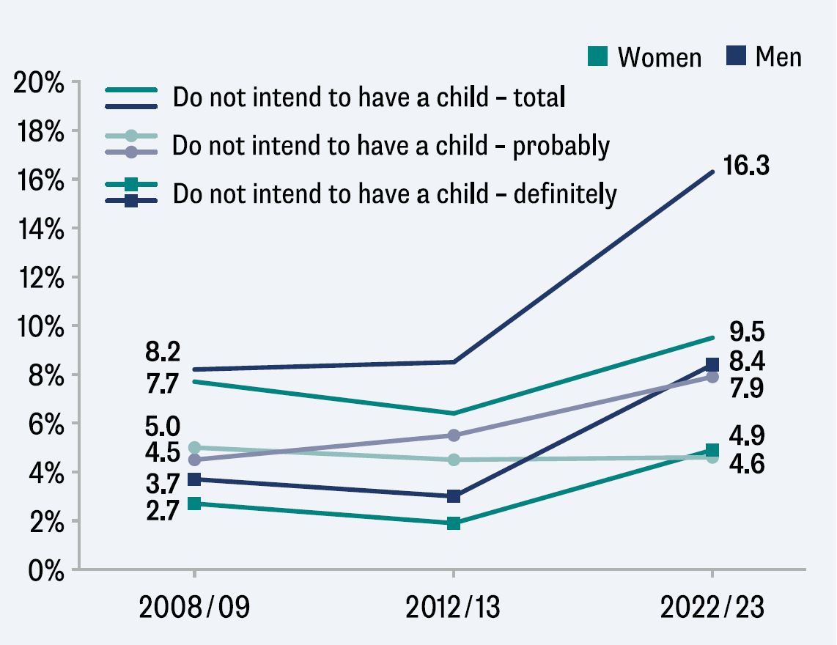
Childlessness: voluntary or unvoluntary?
Age and gender differences: Childlessness intentions and uncertainty more frequent among men
Intention to remain childless has increased over the last decade
Source: Sobotka & Zeman (2023; [27])

Slide 15
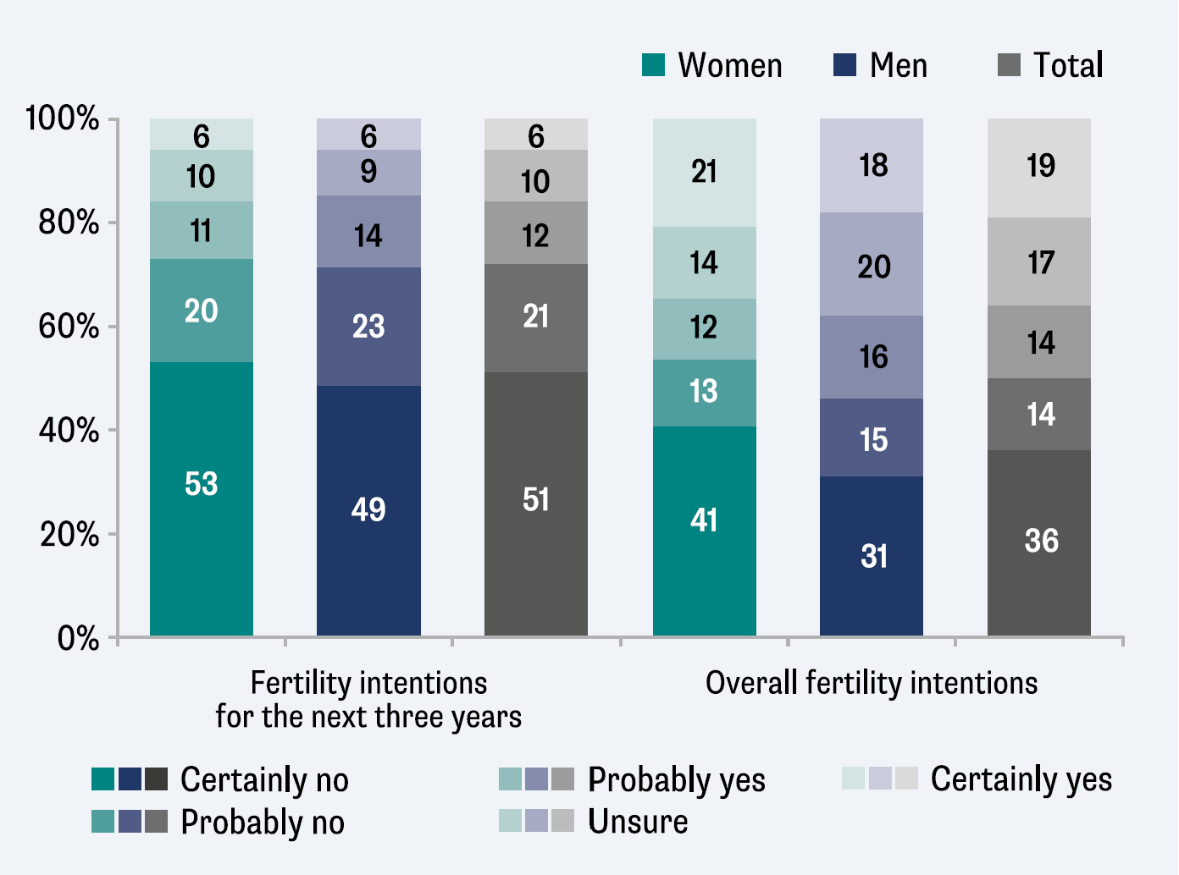
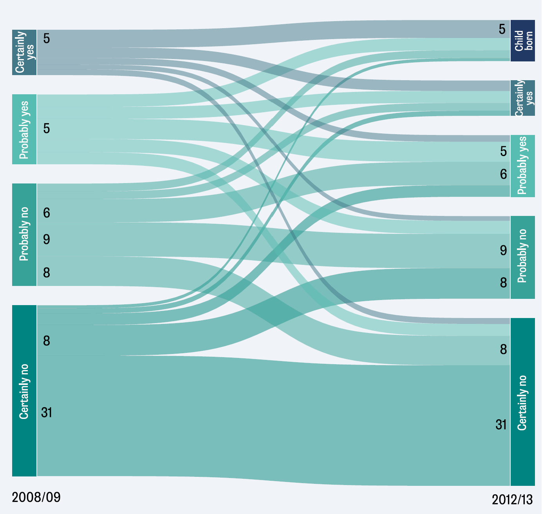
Uncertainties in fertility intentions
2008/09 and 2012/13: Dynamics in short-term intentions, especially among childless
2022/23: Roughly one in two is undecided about future childbearing plans
Source: Buber-Ennser (2023; [26])

Slide 16
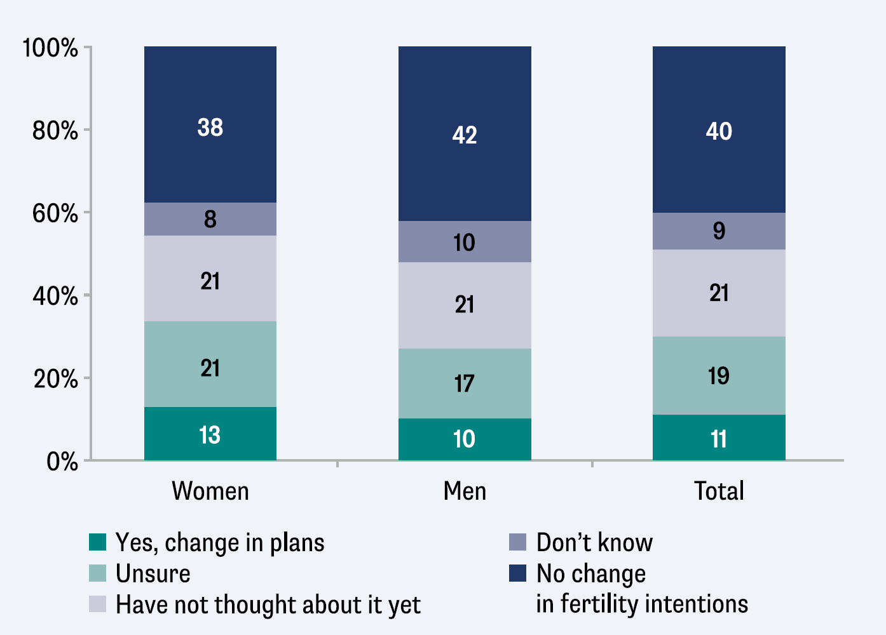
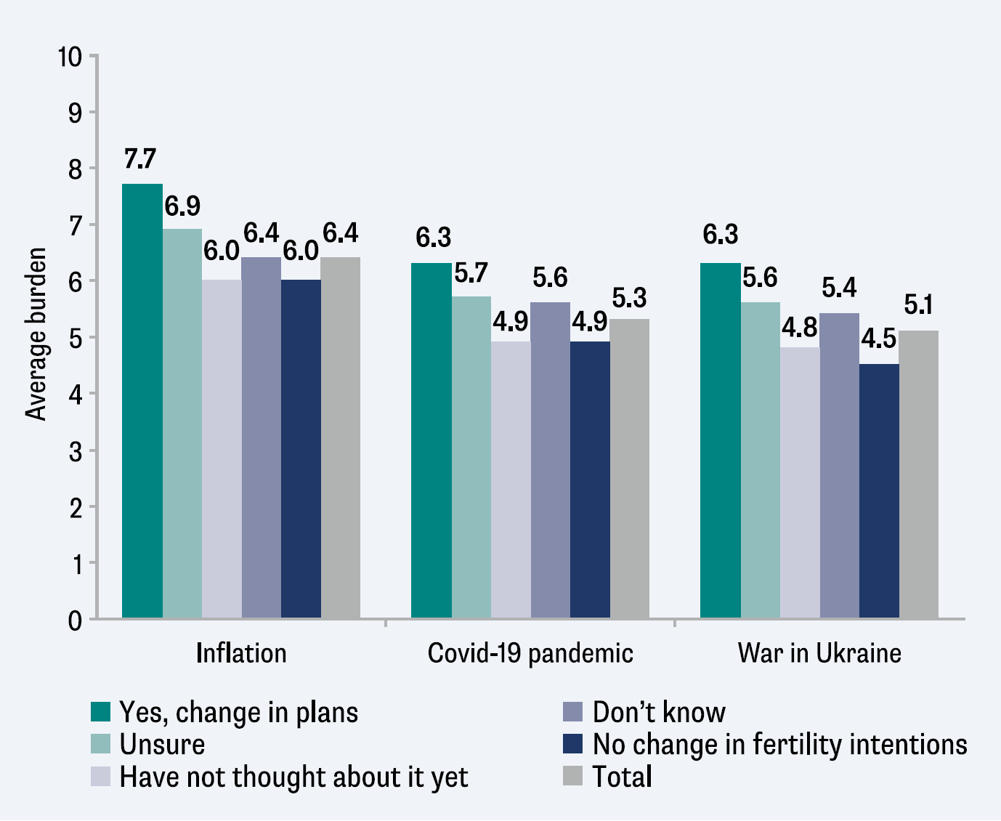
Change in fertility intentions due to the global crises?
Global crises influence fertility intentions of one in three people
Clear link between changes in family plans and perceived stress due to global crises
Source: Buber-Ennser & Herbst (2023; [66])

Slide 17
Experiences from dissemination

Slide 18
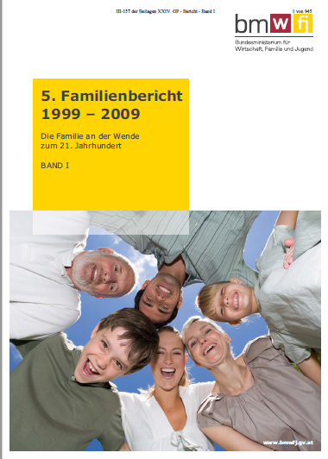
Brochures, Family Reports

Slide 19
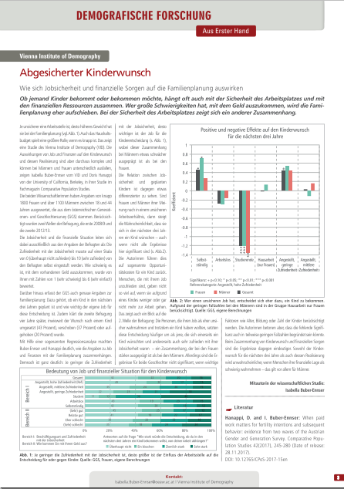
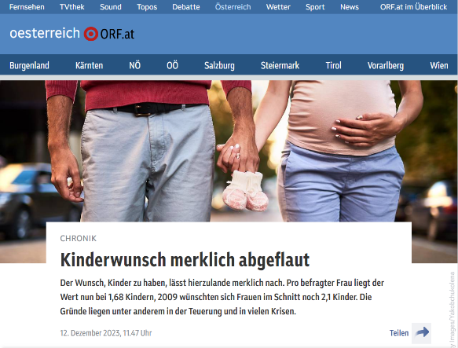
Dissemination to general public

Slide 20
First studies coming up …
Wernhart, G. (2024) Partnerschaftsstabilität bei Akademiker:innen. (Partnership stability among academics)
Neuwirth, N. et al. (2024) Partnerschaftsstabilität in Zeiten multipler Krisen. (Partnership stability in times of multiple crises)
Kaindl, M. / N.Neuwirth (2024) Living Apart Together – Nur eine Vorstufe oder eine langfristige Form der Partnerschaft? (LAT – just a preliminary stage or a long-term form of partnership?)
Geserick, C. / S.Buchebner-Ferstl (2024) Arbeitsteilung gleichgeschlechtlicher Paare. (Division of labor for same-sex couples.)
Dörfler-Bolt, S. / N.Neuwirth (2024) Homeoffice – gekommen um zu bleiben? (Home office – has it come in to stay?)
S.Buchebner-Ferstl et al. (2024) Kinder(wunsch), Partnerschaft, Glück und Zufriedenheit – Reflexionen über ein komplexes Thema (Child (intensions), partnership, happiness and satisfaction - reflections on a complex topic)
N.Neuwirth (2024): Had at least two siblings? Sequence of life events of adults that have grown up in multiple-child families
E. Schmidt et al. (2024): Have children become less important for a fulfilled life?
N.Neuwirth et al. (2024): Not again! The impact of recent crises on Austrian families

Slide 21
Data dissemination
AUSSDA
GGP.at R1W1
GGP.at R1W2 … will come up soon
GGP.at R2W1
NIDI – server
GGP.at R1W1
GGP.at R1W2
GGP.at R2W1 … should come up soon

Slide 22
Future trajectory

Slide 23
Projects and workshops
Meetings May 2024 ff: Networking with respresentatives of federate states (Bundesländer), family organisations, social partners and federal government (Bundesregierung)
Workshop: June 2024: Networking for Austrian research infrastrucures in social sciences; organised by Ministry of Sciences (mostly ESFRI & ERIC-projects)
Workshop: November 2024
„Fertility and family trends: Insights from GGP Austria and beyond

Slide 24
Next steps
Finish off all the administrative stuff of GGP.at R2W1
Offer some university-courses with GGP.at & GGP.int
Build up user community (thesis, research projects …)
Extend www.ggp-austria.at
Create some momentum for recent GGP.at with
Family organisations
Social partners
Families departments of some federate states
Federal ministries

Slide 25
Preparation of wave 2
Secure the panel sample
Secure funding – without delays in contracting …
Decide: platform & CAWI-solution
Prepare call for tender

Slide 26
GGP.at
… let‘s get started!
Norbert Neuwirth and Isabella Buber-Ennser

